Slide 1
Generative Fill and Expand
AI Digital Imaging | Session 3
Notes:
Running time, about 50 minutes. Spot it and recall (6). The selection is the instruction (10). Remove, replace, extend (14). How generated layers behave, and naming (8). Worked example and cold reversal (6). When is removing something a lie (4). Options (2).
Prep before class. The three provided photos for Option A (one with something to remove, one with something to replace, one to extend), posted on Canvas. One photo of your own with an object removed by Fill where a tell is still visible (a leftover shadow is ideal), for the cold reversal. Check credits and sign-in on the lab machines.
Images for the slots: a before and after removal, and one of the "expanded famous painting" images that went around in 2022 or so (August Kamp's outpainted Girl with a Pearl Earring is the well-known one; the original painting is public domain, the expanded version is hers, so show it in class rather than redistributing it).

Slide 2
Spot it
One image. Ninety seconds.
What's wrong with it?
Say where, and what kind.
image: a generated image with a problem the room hasn't seen yet
Notes:
Spot it, about four minutes. Put the image up and say nothing for a few seconds. Then: what's wrong with it? Hands up, one error per person, and make them say where it is and what kind of error it is, in the checklist words once we have them (anatomy, perspective, light, lettering, repeated texture, sheen). Count the errors out loud as they come in. Don't confirm or correct until the room stops finding things, then add the one they missed, if there is one.
This opener runs every class. The point is repetition: by week four the room finds the shadow problem before the hand problem, which is the right order.

Slide 3
Last time
Subject, composition, lens, light, style.
One variable at a time.
Words can't carry "where."
Notes:
Recall, thirty seconds. [Cold call.] What are the five parts? And what did you find when you only changed the light?
[Take one or two answers from people who did Option A. Usually: changing the light also changed the color of everything, and sometimes the composition moved, which was the seed.]
And from Option B: what got through from the film still, and what didn't? [Almost always: placement and value pattern got lost.]
Good, because today's tools are the answer to the "where" problem, at least partly. Today the selection carries the "where."

Slide 4
Two tools, one idea
Fill – inside a selection.
Expand – outside the frame.
In both, the selection is the instruction.
Notes:
Two tools today, and they're really one tool.
Generative Fill works inside a selection. You make a selection on an image, click Generative Fill in the contextual bar, type something or nothing, and you get three variations on a new layer.
Generative Expand works outside the frame. You use the Crop tool to drag the canvas bigger than the image, and it fills the new area.
In both cases the most important input isn't the words. It's the selection: where it is, how big it is, and what it includes. The words matter less than people expect. The shape you draw matters more.

Slide 5
The selection is the instruction
Notes:
So let's look at selections first.

Slide 6
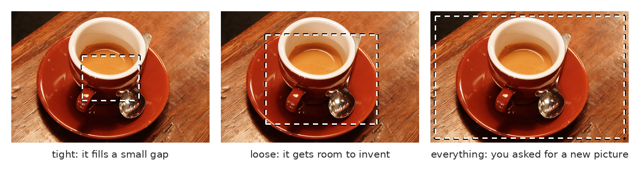
How much you hand over
A tight selection fills a gap. A loose one invites invention. Everything is a new picture.
Notes:
Three selections on the same photo.
On the left, a tight selection around one small area. The generator has a lot of real image around it to match, and only a small hole to fill, so it behaves: it continues the textures and the light that are already there.
In the middle, a loose selection. Now it has room, and it'll use the room. It invents. Things appear that weren't in the photo, sometimes useful, sometimes strange.
On the right, select everything and you haven't asked for an edit at all, you've asked for a new picture that happens to be shaped like your canvas.
So the size of the selection is really a dial for how much of the decision you're keeping and how much you're handing over.

Slide 7
What the selection tells it
Where to work.
How much to invent.
What to match at the edges.
Notes:
Three things the selection tells it. Where to work, which is obvious. How much to invent, which we just saw. And what to match, because the generator looks at the pixels just outside your selection to decide what goes inside.
That last one is why a selection that hugs an object too tightly gives you a bad result. If you select a person and their outline exactly, the generator sees the edge of the person and tries to continue it, and you get a ghost of them. Select a little past the object, into the background, so it can see what's behind.
And it's why feathering matters. A soft-edged selection blends; a hard edge leaves a seam.

Slide 8
Three jobs
Remove
leave the prompt empty
Replace
describe only the new thing
Extend
grow the canvas
Notes:
Three jobs, and almost everything you'll do with these tools is one of them.
Remove: get something out of the picture. Replace: swap something for something else. Extend: make the picture bigger than it was.
Each one has its own habits, and I'm going to go through them quickly, because Option A tonight is one of each.

Slide 9
Remove
Leave the prompt empty.
Select a little past the object.
Check the shadow and the reflection.
image: a photo before and after Generative Fill removed an object
Notes:
Remove. Select the thing plus a margin around it, and leave the prompt empty. An empty prompt tells it to fill with whatever belongs there, which is what you want. (There's also a dedicated Remove tool, a brush, that's often better for small things like wires or blemishes.)
Then check two things that it very often forgets: the shadow and the reflection. You remove a person from a beach, and their shadow is still lying on the sand with nobody attached to it. You remove a car, and it's still reflected in the shop window.
That leftover shadow is one of the most common tells in the world, and it's been a tell since long before generators. Retouchers have been missing shadows since the darkroom.

Slide 10
Replace
Select the shape of the new thing.
Describe only the new thing.
Not the whole scene.
Notes:
Replace. Two habits.
First, the selection is a silhouette. If you want a tall lamp, draw a tall thin selection. If you want a cat curled up, draw a round low one. The generator tends to fill the shape you give it, so you're drawing the silhouette of the new object with your lasso. (Silhouette again, the same idea that runs through storyboarding and painting.)
Second, describe only the new thing. Not "a living room with a red armchair in the corner." Just "a red leather armchair." It can already see the living room. If you describe the whole scene inside a small selection, it tries to fit the whole scene in there, and you get a tiny living room inside your living room.

Slide 11
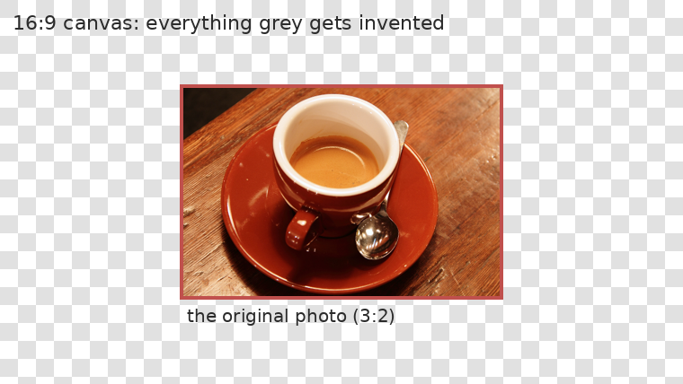
Extend
Crop tool, past the edge.
Everything outside gets invented.
The further out, the weaker it gets.
Notes:
Extend. Pick the Crop tool, drag the edges out past the image, and Generative Expand fills the new area. You can type something or leave it empty.
Look at the diagram. Everything grey is invented. The parts right next to the original photo are strong, because there's real image to continue. The further out you go, the less there is to go on, and the more it starts to make things up: repeated patterns, objects that don't quite make sense, perspective that wanders off.
Two habits: extend in smaller steps, checking each one, rather than one huge jump. And extend away from the subject, into sky, floor and background, where invention is less likely to be noticed.

Slide 12
Expanding changes what it means
What's outside the frame matters.
Most extensions add wallpaper.
A good one adds a fact.
image: an outpainted famous painting from 2022 or so (e.g. the expanded Girl with a Pearl Earring)
Notes:
Here's something to look at, and then argue about. Back in 2022 or so, when this first became possible, people expanded famous paintings to show "what was outside the frame." This one went around everywhere.
[Show it. Give them thirty seconds.] Does the extension add anything to the painting? What does it tell you that you didn't know?
[Let them answer.] Usually, the honest answer is: not much. It's a nice room. It's wallpaper. The original frame was a decision, and the extension mostly dilutes it.
A good extension adds a fact: something in the new space that changes what the image says. Who is she looking at? What's on the table? That's the difference between expanding a canvas and making a decision about it, and it's what Option B asks for: when you expand your photo, note each choice you made, and why.

Slide 13
How generated layers behave
Notes:
Now some practical file behavior, because it affects your process record.

Slide 14
What you get back
A new layer, with a mask.
Three variations each time.
Regenerate, or pick in Properties.
Notes:
When Fill or Expand runs, it doesn't touch your original pixels. It makes a new generative layer with a mask in the shape of your selection. The original stays underneath. That's good, it means everything is reversible.
Each run gives you three variations, and you can flip between them in the Properties panel, or generate more. Pick one, and the others are still there until you delete them.
One thing to watch: the generated area can be lower resolution or softer than the photo around it, especially on big images or big selections. It can look fine zoomed out and mushy at 100%. Zoom in before you accept it. We'll fix that properly when we get to grain and sharpness in session 8.

Slide 15
Naming, for this course
GEN_ for anything generated
FIX_ for a hand correction
REF_ for reference you brought in
CALLOUT for error markup
Date in the file name
Never "Layer 12 copy 3"
Notes:
Here's the naming standard for the rest of the course, and it's worth photographing.
GEN_ at the start of anything generated: GEN_sky_v2. FIX_ for any hand correction: FIX_shadow_left. REF_ for any reference or photo you brought in. CALLOUT for the layer where you mark up errors. And the date in the file name.
This sounds fussy and it takes about five seconds per layer. It's also the process record: when I open your file I can see at a glance what was generated and what you made, which is exactly what the rubric asks, and exactly what a studio would ask too. Nobody should have to guess.

Slide 16
Getting more control
Smaller selections.
Several small passes.
Paint rough first, then fill.
Notes:
Three ways to get more control, from easiest to most useful.
Use smaller selections, so it has less room to invent. Do several small passes instead of one big one, accepting or rejecting each step.
And the most useful: paint something rough first. Block in the shape and color of what you want with a brush, badly is fine, then select over it and fill. The generator looks at what's inside the selection as well as around it, so your rough paint steers it more than words do.
This is the first appearance of an idea we'll keep coming back to: the more of the decision you supply, the less of it gets made for you.

Slide 17
Worked example: one removal
Select
lasso, past the edge
Prompt
leave it empty
Pick
one of three, say why
Check
shadow, edge, grain
Name
GEN_remove_sign
Notes:
One worked example, which I'll do live in the demo, but here's the order.
Select the object with the lasso, including a margin of background. Prompt: nothing. Generate. Pick one of the three variations, and say out loud why that one: "the brick lines continue in this one," not "it looks better." Check the three tells: is there a shadow or reflection left behind, is there a seam at the edge, does the patch match the grain of the photo. Name the layer.
Five steps, about two minutes. The thinking is in the pick and the check.

Slide 18
Now you: what was the selection?
image: a photo of yours where an object was removed with Fill, one tell left visible
Notes:
Cold reversal. Something was removed from this photo with Generative Fill. I'm not going to tell you what.
Three questions, in pairs, two minutes. What was there? Roughly what did the selection look like? And what gives it away?
[Take answers. Don't confirm until several pairs have answered, and then only confirm what was removed, not the whole list of tells. Let them argue about the rest.]
If you found it from a shadow, or a pattern that stops at an invisible line, or an area that's smoother than the rest, you've just done session 4 a day early.

Slide 19
When is removing something a lie?
A news photo?
An ad?
Concept art?
Notes:
Short discussion, four minutes or so. When is removing something from a photo fine, and when is it a lie?
[Let them work it out. Usually they get there: it depends on what the picture claims to be.]
News agencies have had firm rules on this for a long time: in a news photo you don't add or remove anything, because the photo is a claim about what happened. An ad is understood by most people to be constructed, though even there, removing something about the product itself can get a company in trouble. Concept art makes no claim to be true at all.
So it isn't the tool that makes it a lie. It's what the image says it is. Keep that, because it's the whole basis of disclosure in week three.
[Into the demo.]

Slide 20
In the wild: a family photo
A royal family photo, 2024.
Agencies pulled it within hours.
Nothing generated. Still a problem.
image: the 2024 Princess of Wales Mother's Day photo, with the agency notice
Notes:
[About five minutes.] A real case, and a useful one exactly because no generator was involved.
In March of 2024, the Princess of Wales released a family photo for Mother's Day. Within hours, several of the big news agencies withdrew it and told their clients not to use it, a "kill notice," because people had spotted signs of editing: a sleeve that didn't line up, a zipper, bits of background that didn't continue. She later said she had been experimenting with editing, and apologized for the confusion.
[Ask: why did the agencies care so much about a sleeve?] Because a news agency's whole value is that its photos are what happened. One edited photo, even a harmless one, makes people question every other one.
Notice the tells, too. They're the same ones we're learning for generated images: edges that don't line up, patterns that stop at an invisible line. A careless edit and a careless fill leave the same fingerprints.

Slide 21
Words from today
Generative Fill – generates inside a selection
Generative Expand – generates past the canvas edge
Generative layer – its own layer, with a mask, three variations
Feather – a soft selection edge
Aspect ratio – the shape of the frame, like 16:9
GEN_ / FIX_ / REF_ – the naming standard for every file
Notes:
Thirty seconds. Read the terms aloud and ask the room for any they can't explain yet. These are on Canvas as a running glossary, which helps everyone and helps accommodated students most, on a schedule where the next class is often tomorrow.

Slide 22
Before next class: pick one
Option A, guided
Option B, own material
Three provided photos.
Remove, replace, extend.
One each, layers named.
Expand your own photo
to a new aspect ratio.
Note each choice you made.
Notes:
Tonight, due at the start of next class.
Option A: three photos on Canvas, three jobs. Remove something from the first, replace something in the second, extend the third. Layers named to the standard: GEN_, FIX_ if you touched it up, and so on.
Option B: one of your own photos, expanded to a new aspect ratio, for example a horizontal photo made vertical for a phone screen. Write down each choice you made: what you let it invent, what you rejected, what the new space adds to the image (or doesn't).
Same rubric, either way.

Slide 23
The selection is the instruction.
One line to take home
The words matter less than the shape you draw.
Notes:
The selection is the instruction. The words matter less than the shape you draw. [Demo.]

